Slide 1
2017 East Stanislaus Integrated Regional Water Management Plan Update
Presenter:
Leslie Dumas
December 14, 2017

Slide 2
Meeting Agenda
Introductions
Summary of Integrated Regional Water Management Program
Overview of 2017 East Stanislaus Integrated Regional Water Management Plan Update
Next Steps

Slide 3
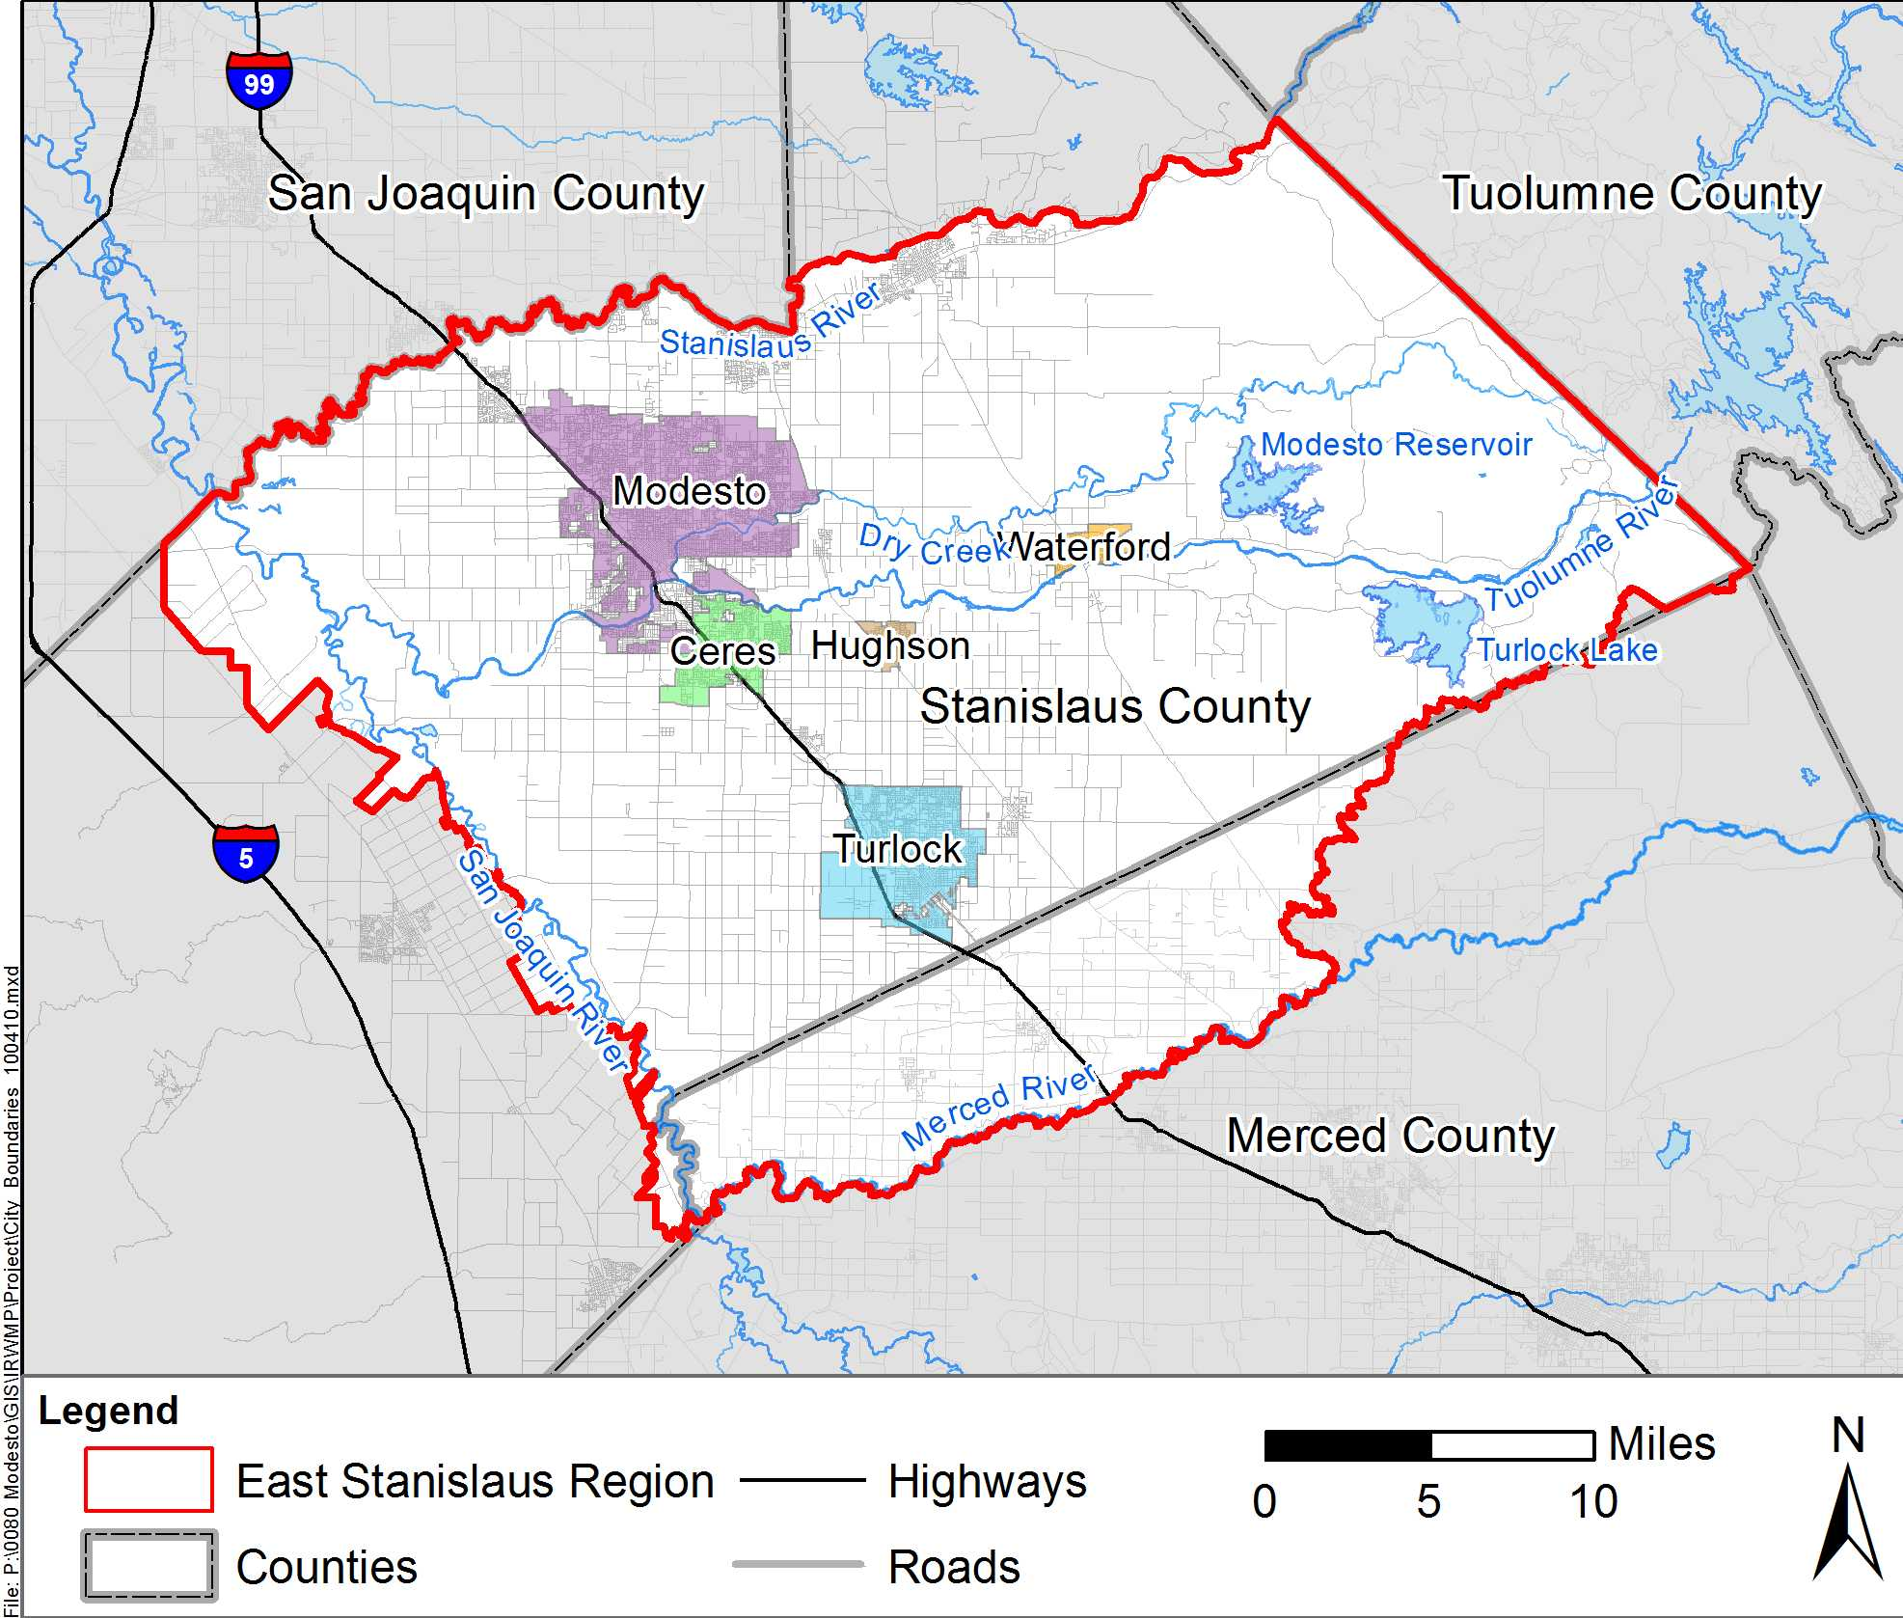
Introductions
ESRWMP Members
City of Modesto
City of Hughson
City of Ceres
City of Turlock
City of Waterford
Stanislaus County
Consultant
RMC / Woodard & Curran

Slide 4
Meeting Agenda
Introductions
Summary of Integrated Regional Water Management Program
Overview of 2017 East Stanislaus Integrated Regional Water Management Plan Update
Next Steps

Slide 5
An Integrated Regional Water Management (IRWM) Plan is…
A planning document
A description of water-related resources, challenges, goals, and solutions
An opportunity for regional partnerships and coordination
A vehicle to facilitate State funding

Slide 6
An IRWM Plan is not…
A substitute for local planning
A decrease in agency responsibilities or autonomy
A policy document
Comprehensive project documentation

Slide 7
The Purpose of an IRWM Plan is to…
Develop regional understanding
Identify water resources solutions
Reflect the regional needs
Maximize benefits through integration of water management strategies
Leverage regional resources through partnerships
Be eligible for State funding through the IRWM grant program

Slide 8
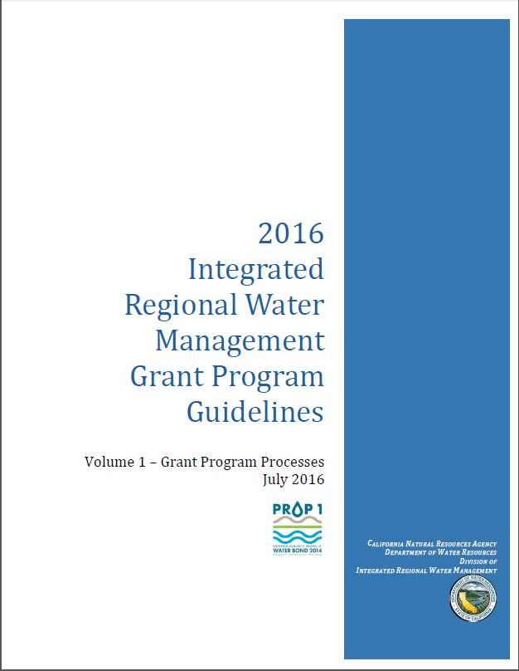
IRWMPs are prepared to meet DWR’s IRWM Guidelines
(July 2016)

Slide 9
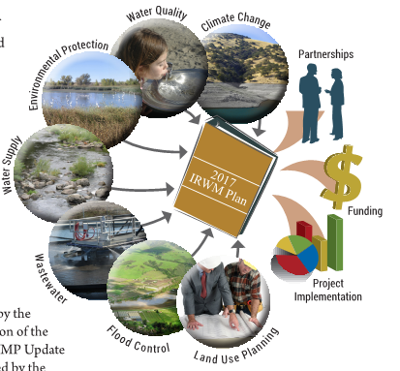
Contributors Include…
Water and Wastewater Agencies
Counties
Cities
Public Groups
Private Organizations
Members of the Public

Slide 10
Parallel Planning Efforts
Stanislaus Multi-Agency Storm Water Resource Plan
Vehicle for stormwater planning and funding
Plan production is underway
DWR requires that IRWMPs must incorporate a SWRP
Disadvantaged Communities Involvement Program
Sustainable Groundwater Management Act (SGMA) and Groundwater Sustainability Plans (GSPs)
Notes:
IRWMP will incorporate SWRP by appending it upon completion of the SWRP

Slide 11
Meeting Agenda
Introductions
Summary of Integrated Regional Water Management Program
Overview of 2017 East Stanislaus Integrated Regional Water Management Plan Update
Next Steps

Slide 12
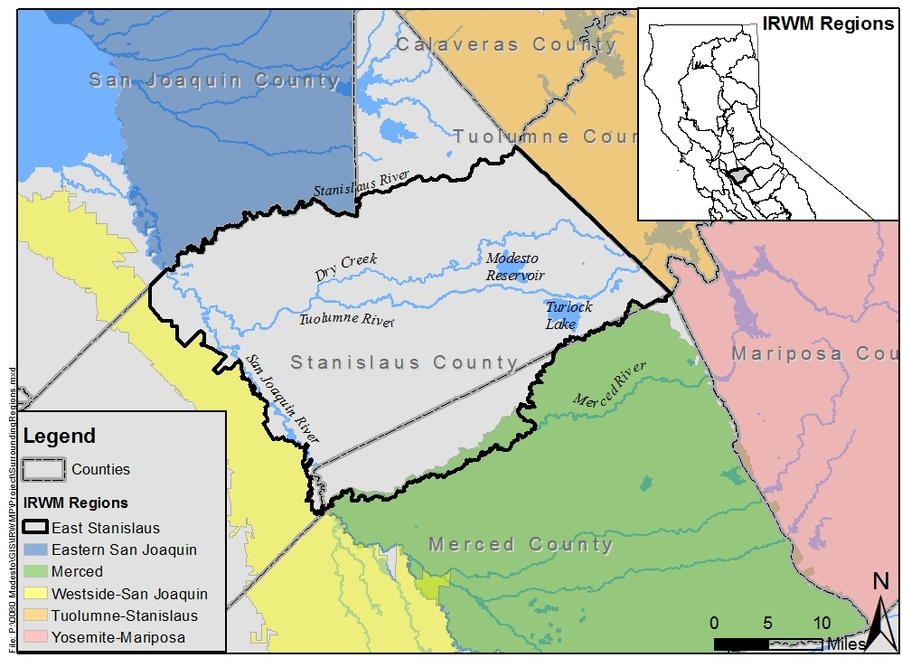
East Stanislaus IRWM Planning Process
The cities of Modesto, Hughson, Ceres and Turlock developed the Region’s first IRWM Plan in 2013.
Formed the East Stanislaus Region and associated Regional Water Management Partnership
Waterford and Stanislaus County joined the ESRWMP in 2017
Received planning and implementation grants.

Slide 13
East Stanislaus Regional Boundaries
North Boundary: Stanislaus River, Modesto Groundwater Basin, and portion of Stanislaus County border
East Boundary: Tuolumne-Stanislaus IRWM Region
West Boundary: San Joaquin River & Westside-San Joaquin IRWM Region.
South Boundary: Merced River Watershed, the Turlock GW Basin, and the TID boundaries

Slide 14
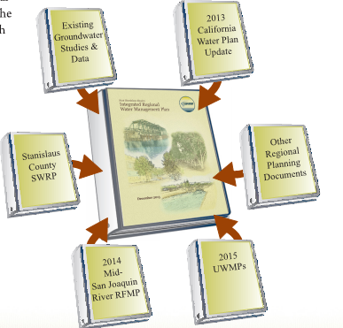
Now it’s Time to Update the IRWMP
Comply with DWR’s 2016 IRWM Guidelines for to be eligible for Prop 1 implementation grants
Incorporate planning efforts since 2013 to keep IRWM Plan current
Public Draft IRWMP Update released for public review on 12/11
Notes:
The public draft is available on the ESIRWM website, and hard copies are available upon request from Jim

Slide 15
East Stanislaus IRWM Planning Process
Identify Projects to Meet Objectives
Integrate Projects
Prioritize Projects
Develop Implementation Strategies
Develop Regional Objectives
Notes:
These steps were first performed for the 2013 IRWMP. For 2017, they were revisited and updated to comply with the 2016 IRWM Guidelines and reflect any changes in regional conditions.

Slide 16
Outline of the East Stanislaus IRWMP
Chapter 1 Introduction 1.1 IRWMP Overview 1.2 Regional Water Management Group 1.3 IRWMP Development 1.4 IRWMP Adoption Chapter 2 ESIRWM Region 2.1 Region Description 2.2 Water Resource Status 2.3 Climate Change Impacts Chapter 3 Climate Change 3.1 Introduction 3.2 Statewide Observation and Projections 3.3 Legislative and Policy Context 3.4 Regional Climate Change Projections and Impacts 3.5 Regional Water Resource Vulnerabilities 3.6 Climate Change Adaptation and Mitigation 3.7 Plan for Further Data Gathering Chapter 4 ESIRWM Governance, Coordination and Outreach 4.1 Governance 4.2 Stakeholder Involvement and Outreach 4.3 Coordination with Other/Neighboring IRWM Regions 4.4 Coordination with State/Federal Agencies 4.5 Coordination with Regional and Local Agencies | Chapter 5 Vision, Goals, and Objectives 5.1 Regional Conflicts and Issues 5.2 Region’s Vision for Water Resources Management 5.3 Region Goals & Objectives 5.4 Relation to Statewide Priorities 5.5 Relation to Regulatory Programs 5.6 Relation to Local Water Planning 5.7 Relation to Local Flood Control Planning 5.8 Relation to Local Land Use Planning Chapter 6 Resource Management Strategies 6.1 RMS Identification 6.2 RMS Descriptions Chapter 7 Project Review Process 7.1 Project Solicitation 7.2 Project Review and Integration 7.3 Project Prioritization 7.4 Impacts and Benefits Chapter 8 Technical Analysis and Data Management 8.1 Technical Analysis 8.2 Data Management Chapter 9 Plan Implementation 9.1 Implementation Process 9.2 Financing Plan 9.3 Plan Performance and Monitoring 9.4 Plan Updates Chapter 10 References

Slide 17
Chapter 1 - Introduction

Slide 18
Introduction
Plan Standard | East Stanislaus IRWMP Chapter to Reference
Governance | 4.1
Region Description | Chapter 2
Objectives | Chapter 5
Resource Management Strategies | Chapter 6
Integration | 7.2
Project Review Process | 7.1, 7.2, 7.3
Impacts and Benefits | 7.4
Plan Performance and Monitoring | 9.1, 9.3, 9.4
Data Management | 8.2
Finance | 9.2
Technical Analysis | 8.1
Relation to Local Water Planning | 5.6, 5.7
Relation to Local Land Use Planning | 5.8
Stakeholder Involvement | 4.2
Coordination | 4.3, 4.4, 4.5
Climate Change | Chapter 3
Describes the purpose of the IRWMP
Introduces the East Stanislaus Regional Water Management Partnership
Explains that each DWR Plan Standard is addressed
Lists entities that adopted the IRWMP

Slide 19
Chapter 2 – ESIRWM Region

Slide 20
Chapter 2 Describes the Region Boundaries
Notes:
Describe how the region’s boundaries are heavily based on the surrounding regions boundaries

Slide 21
The East Stanislaus Region Includes…
Portions of Stanislaus and Merced Counties
Cities of Modesto, Hughson, Turlock, Ceres, Riverbank, Waterford, and Oakdale
Communities of Keyes, Denair, Del Rio, Riverdale, Grayson, Hickman, Empire, Salida, Hilmar, and Delhi
Turlock Irrigation District, Modesto Irrigation District, Eastside Irrigation District, and Oakdale Irrigation District

Slide 22
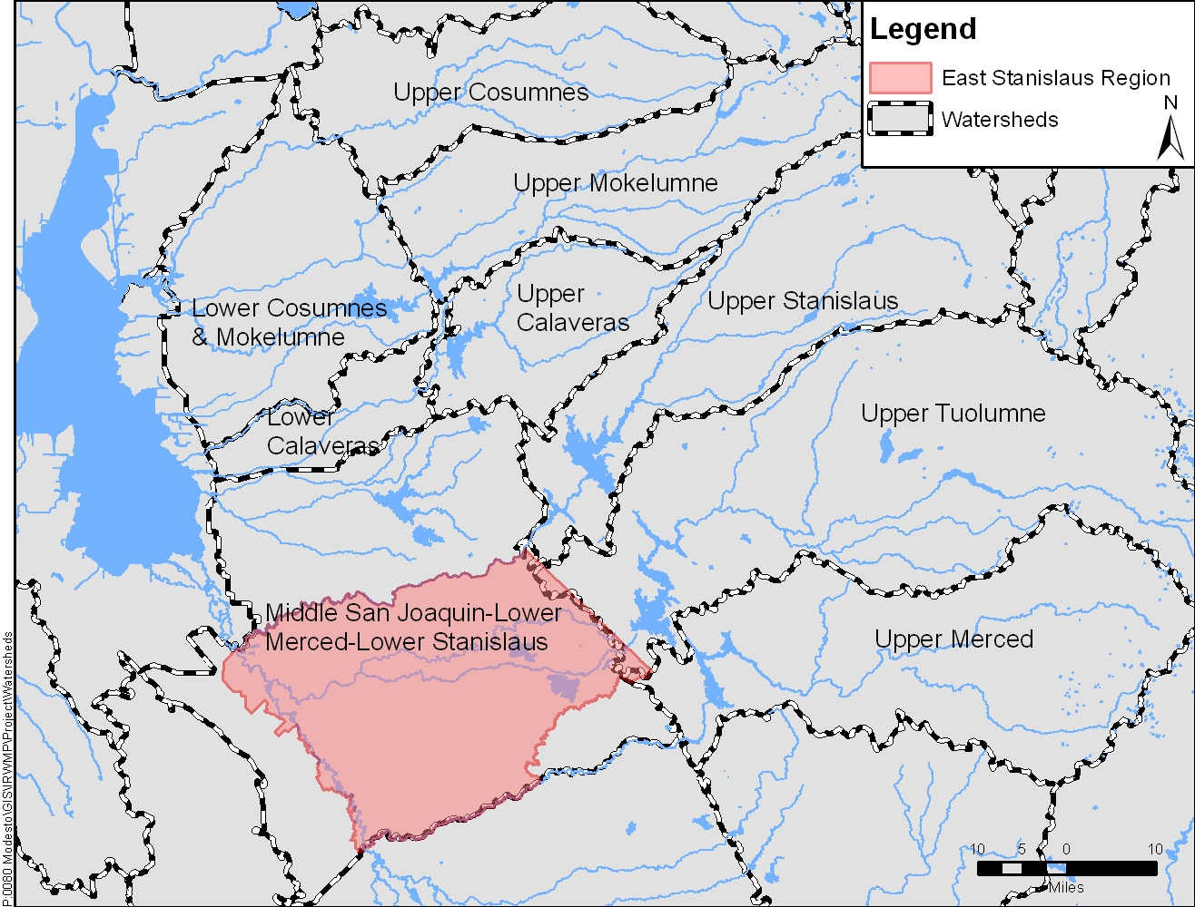
Chapter 2 Describes Watersheds
Notes:
The Merced, Stanislaus and Tuolumne River watersheds are three watersheds within the San Joaquin River Basin and these are the primary surface water watersheds that drain to the Middle San Joaquin-Lower Merced-Lower Stanislaus Watershed in which the East Stanislaus region is almost entirely located

Slide 23
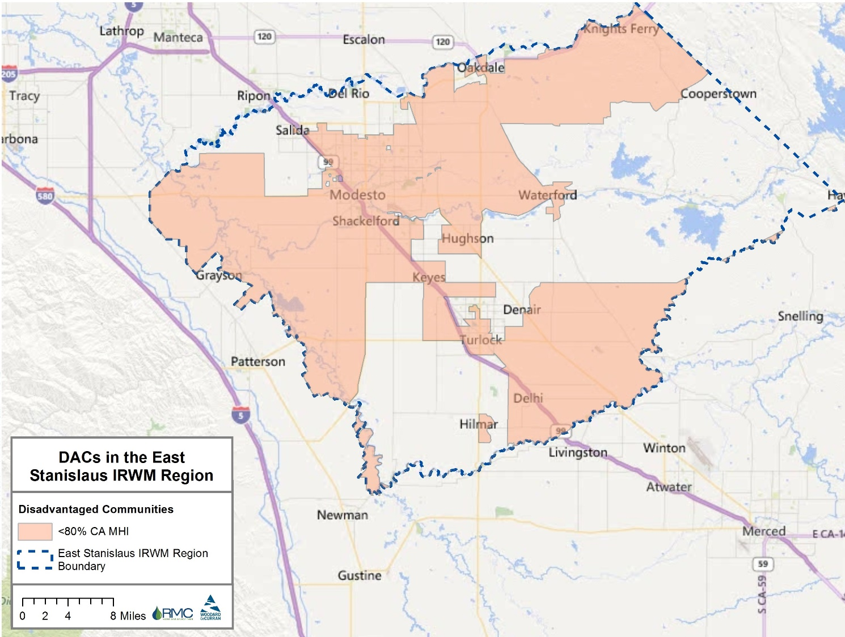
Chapter 2 Describes Region Demographics
Notes:
Social and Cultural Makeup (map shows DACs in the region)
Ch 2 describes (next few slides demonstrate this):
Climate
Social and Cultural Makeup
Watersheds
Groundwater Basins
Surface Water Bodies
Natural Resources

Slide 24
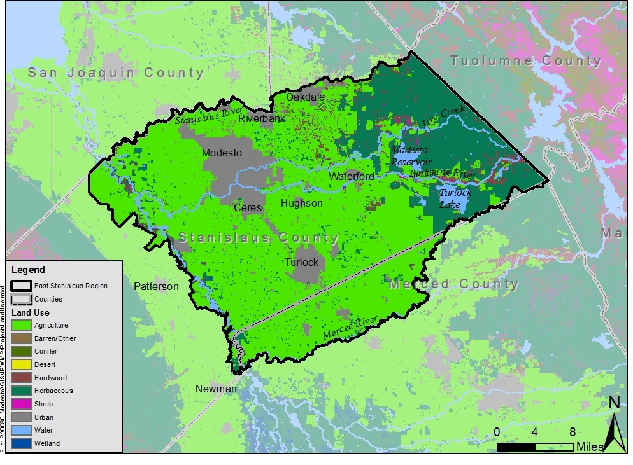
Chapter 2 Describes Land Use
Notes:
Land Cover – primarily ag

Slide 25
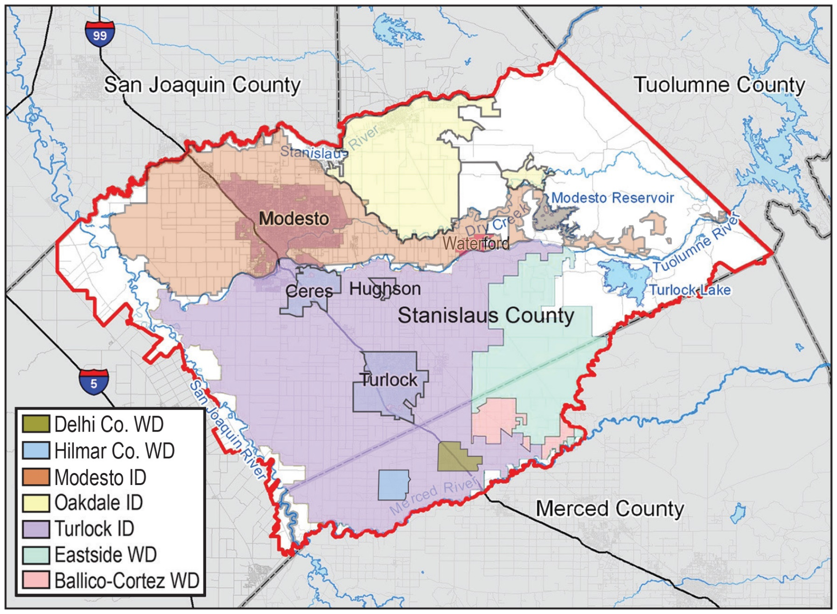
Chapter 2 Describes Water Providers
Notes:
Water/ww agencies in the region

Slide 26
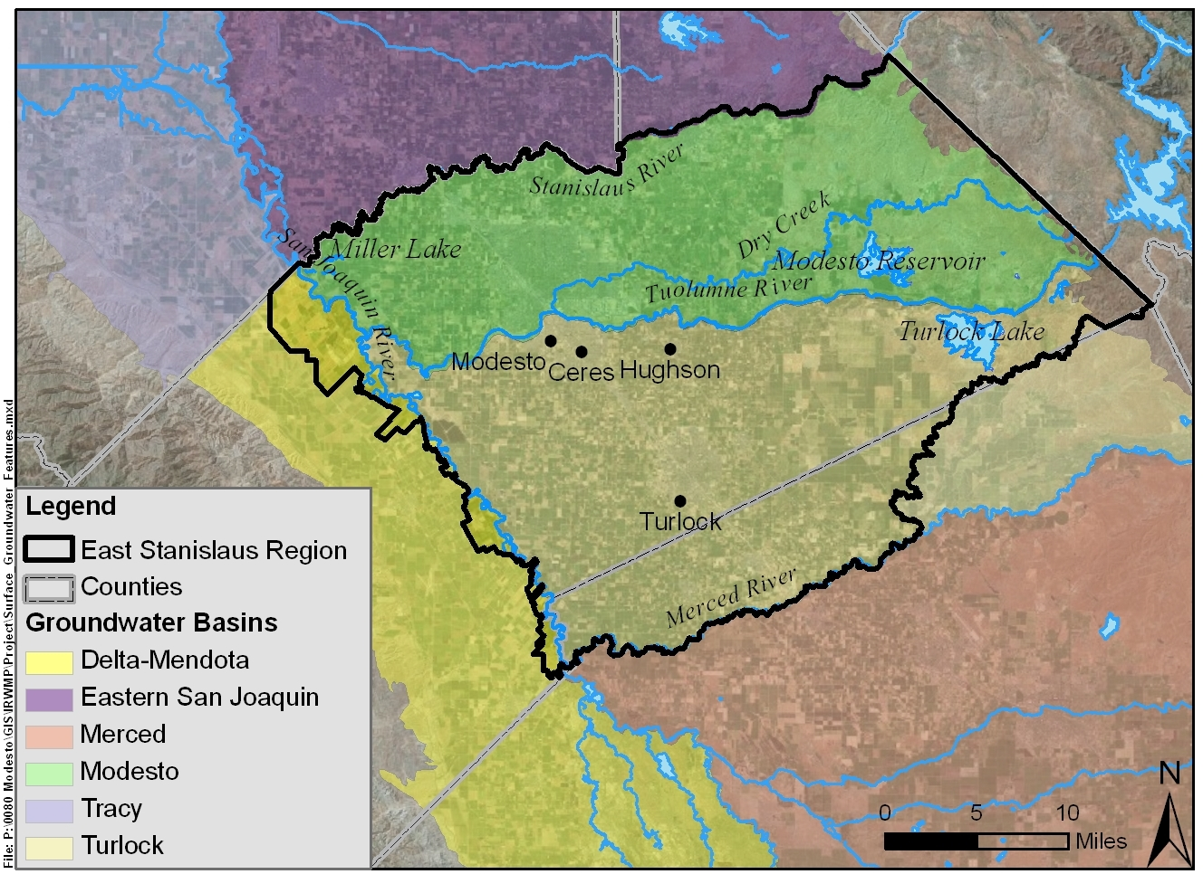
Chapter 2 Describes Groundwater Basins
Notes:
Groundwater basins – Modesto and Turlock Subbasins are within the region

Slide 27
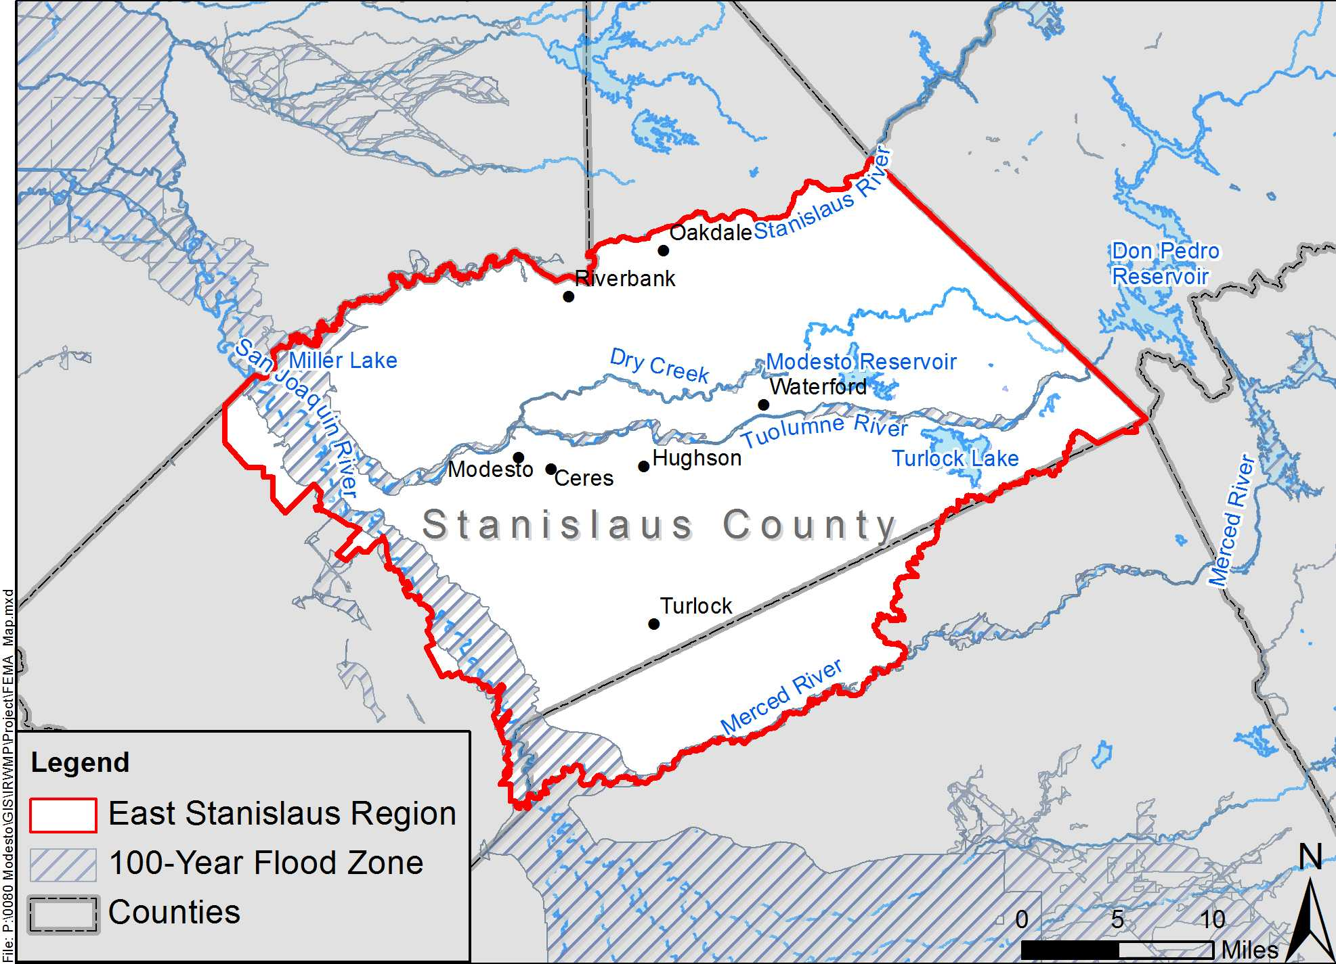
Chapter 2 Describes Flood Zones
Notes:
100-year floodplain

Slide 28
Chapter 2 Summarizes Water, Wastewater, and Recycled Water in the Region
Water supplies and demands
Wastewater treatment and collection
Potential for recycled water use (e.g. North Valley Regional Recycled Water Project)
Water quality

Slide 29
Chapter 3 – Climate Change

Slide 30
Climate Change Vulnerabilities
Reduced surface water availability
Reduced groundwater supply reliability
Potential increase in groundwater overdraft
Declining water quality
More severe flooding events
Loss of riparian habitat, wetlands and other sensitive natural communities
Reduced hydroelectric generation capacity
Notes:
Reduced groundwater supply reliability as a result of reduced groundwater recharge and runoff

Slide 31
Climate Change Adaptation & Mitigation
Climate adaptation includes:
Adaptation strategies (policies, programs or other actions) that bolster resilience
Mitigation strategies (best management practices or other measures) to reduce GHG emissions.
Adaptation and mitigation strategies were discussed in the Resource Management Strategies Chapter

Slide 32
Chapter 4 – Governance, Coordination, and Outreach

Slide 33
Governance Structure
East Stanislaus Regional Water Management Partnership (ESRWMP)
Steering Committee (SC)
Public Advisory Committee (PAC)
Other Committee, as necessary
Other Committee, as necessary
Public
Consultant

Slide 34
ESRWMP and Committees
ESRWMP
Elected officials from six ESRWMP member agencies
Facilitates communication, cooperation, and education between member agencies
Steering Committee
Leads preparation and implementation of the IRWMP
Manages IRWM contracts, databases, and reporting
Public Advisory Committee
Provides input and recommendations to ESRWMP and SC
Provides oversight to SC and PAC
Meetings are held as needed
Manages IRWM budgets and schedules
Conveys PAC recommendations to the ESRWMP
Open to all
First tier of decision making
Provides feedback on changes to IRWMP
ESRWMP member agency staff that actively manage projects

Slide 35
Chapter 5 – Vision, Goals, and Objectives

Slide 36
Shared Issues and Conflicts
Water supply reliability
Drinking water quality
Water quality protection
Groundwater overdraft / contamination / recharge
Protection and enhancement of aquatic, riparian, and watershed resources
Water-related needs of disadvantaged communities
Flood protection
Recycled water use
Water conservation
Aging infrastructure

Slide 37
The East Stanislaus Region’s IRWM Vision
Integrate projects to provide multiple benefits, resolve identified issues and conflicts, and meet the regional goals and objectives to achieve water reliability and sustainability and flood protection while protecting and enhancing the environment and regional economies and culture.

Slide 38
Identified Regional Goals
Water Supply
Protect existing water supplies and water rights, and improve regional water supply reliability.
Flood Protection
Ensure flood protection strategies are developed and implemented through a collaborative process, utilizing both local and watershed-wide approaches designed to maximize opportunities for comprehensive water resource management that meet multiple objectives.
Water Quality
Protect and improve water quality for beneficial uses consistent with regional interests and the RWQCB Basin Plan in cooperation with local, state and federal agencies and regional stakeholders.

Slide 39
Identified Regional Goals
Environmental Protection and Enhancement
Protect the environmental resources of the Stanislaus, Tuolumne, Merced and San Joaquin River watersheds by identifying, promoting and implementing opportunities to assess, restore and enhance natural resources of these watersheds.
Regional Communication and Cooperation
Implement and promote the East Stanislaus IRWM Plan through regional communication, cooperation, and education.
Economic and Social Responsibility
Promote development and implementation of projects, programs and policies that are socially impartial and economically sound.

Slide 40
Chapter 6 – Resource Management Strategies

Slide 41
Resource Management Strategies (RMS)
Intended to encourage a diversified approach to water management
RMS are defined in DWR’s 2013 California Water Plan Update
RMS were considered in terms of:
Supporting Regional goals
Climate change adaptation/mitigation

Slide 42
RMS Categories
RMS Categories are:
Reduce Water Demand
Improve Operational Efficiency and Transfers
Increase Water Supply
Improve Water Quality
Improve Flood Management
Practice Resource Stewardship
People and Water
Other Strategies
Notes:
Categories of applicable Resource Management Strategies (RMSs), as identified in the 2009 California Water Plan Update
Within each RMS category listed above, a variety of specific strategies were identified for the region and described in Chapter 3.
“Other strategies” includes crop idling, irrigated land retirement, fog collection, rainfed agriculture, dewvaporation, and waterbag transport

Slide 43
Chapter 7 – Project Review Process

Slide 44
Project Solicitation and Prioritization
Project Solicitation opened August 7, 2017
Public Workshop held August 15, 2017
Project Solicitation closed on September 29, 2017
52 projects submitted
2 were combined/integrated
23 denoted ‘Ready-to-Proceed’ → prioritized
28 denoted ‘Conceptual’

Slide 45
Projects that were Prioritized
Mustang Creek MAR Project
Rouse Lake Managed Aquifer Recharge (MAR) Project
North Valley Regional Recycled Water Project
SRWA Regional Surface Water Supply Project
Dos Rios Floodplain and Riparian Habitat Restoration
Regional Surface Water Treatment Plant Pipeline Turnout
Catherine Everett Park Cross Connection Elimination
JM Pike Park Cross Connection Elimination
East Stanislaus Watershed Outreach and Education
Regional Water Needs Assessment
Tuolumne River Non-Motorized Boat Launch
Tuolumne River Regional Park
Non-Potable Water System
7th Street Low Impact Development (LID) Storm Drainage Improvements
TRRP - Carpenter Road/West Modesto Flood Management and Park Development
Modesto Area 2 Stormwater to Sanitary Sewer Cross-Connection Removal Project
DAC and Native American Outreach and Technical Assistance
Sutter Wastewater Treatment Plant Relocation Project
South Modesto Infrastructure Efficiency Improvements
Dennett Dam Removal
Online Data Management System
Grayson Water System Efficiency improvements
F St Storm Pond
Notes:
Projects were submitted by the Cities of Modesto, Hughson, and Turlock, and others.

Slide 46
Chapter Summarizes Impacts and Benefits from Plan Implementation
Potential impacts and benefits by project type (e.g., groundwater, conservation, wastewater)
Impacts and benefits associated with plan implementation at the regional and interregional scales
Benefits and impacts to Disadvantaged Community (DACs), Environmental Justice-Related Concerns, and Native American Tribal Communities

Slide 47
Chapter 8 – Technical Analysis and Data Management

Slide 48
Prepared Using Sound Technical Documents
IRWM Plan developed using:
Urban Water Management Plans (UWMPs)
Water Supply Plans
Draft Regional Flood Management Plan
EIRs/EISs
Feasibility Studies
General Plans

Slide 49
Chapter 8 Describes
Why the information is good for use in developing the IRWM Plan
Identified data gaps in regional understanding
Notes no additional focused models or studies were performed
Identifies recommended additional studies

Slide 50
Chapter 8 Describes Data Needs and Dissemination
Presents list of data that may be collected during plan implementation
Summarizes Regional data needs
Most data gaps are in unincorporated areas
Identifies data gaps
Summarizes studies to fill data gaps
Discusses data dissemination – website, meetings and workshops, uploads to state databases
Describes state database compatibility
Notes:
Identifies data gaps in demand projections, local hydrogeology information, areas conductive to groundwater banking, data pertaining to localized flooding and stormwater management

Slide 51
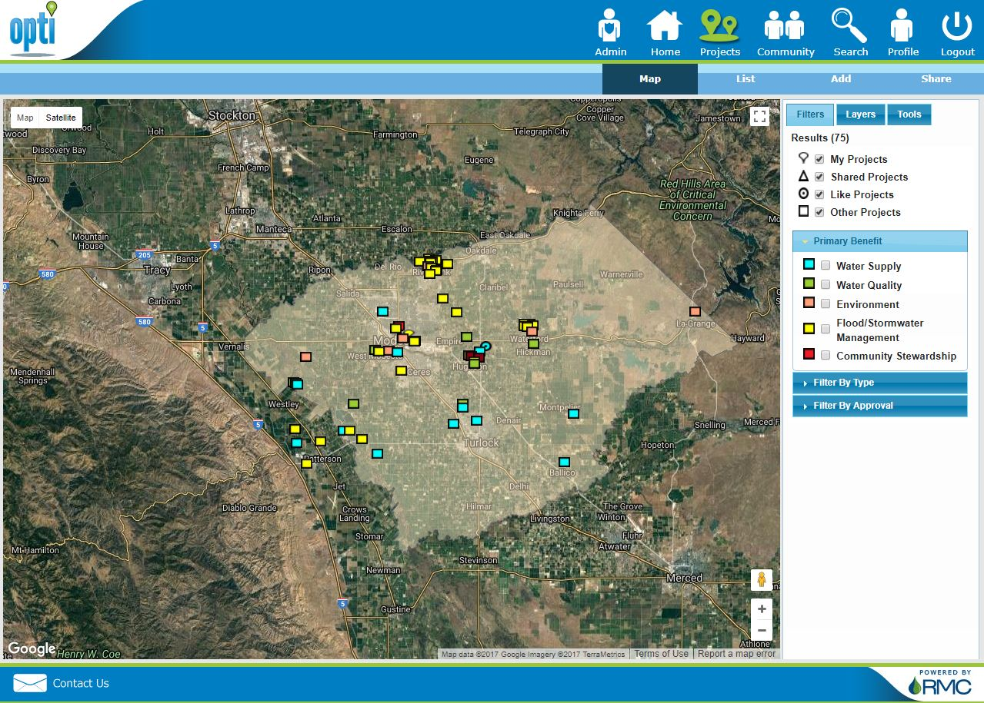
Chapter 8 Describes Data Collection and Storage
What is currently being done
Identifies regional data management system (DMS)
Individual stakeholders and project proponents responsible for data collection, review, management
Notes:
Current DMS is OPTI – but project information only. Lacking funding to expand to include other data
Section also identifies individual stakeholders and project proponents as responsible for collecting, reviewing, managing and reporting project-specific data

Slide 52
Chapter 9 – Plan Implementation

Slide 53
Potential Funding Sources for IRWMP Implementation
Capacity fees
User fees and rates
General or Capital Improvement Funds
Bonded Debt Service
Grants
Low-Interest Loans

Slide 54
Chapter 9 Addresses Project Monitoring
Plan performance monitoring
Individual project proponents responsible for project-specific monitoring plans
Outlines ESRWMP role in project performance monitoring
Describes how data will be used to improve the IRWM Plan (adaptive management)
Notes:
Plan performance monitoring based on project-specific performance monitoring and cumulative progress
Individual project proponents responsible for developing and implementing project-specific monitoring plans
Project-specific monitoring plans submitted to ESRWMP for review and consideration
Outlines ESRWMP role in project performance monitoring as the overseeing entity
Describes how data collected will be used to improve the IRWM Plan implementation

Slide 55
Long-Term Maintenance Activities
Activity | Frequency*
ESRWMP Meetings (financing, regional water resources issues, other) | As needed
Project Solicitation, Review, Integration and Prioritization | As needed, no less than every 5 years
Plan and Project Monitoring and Performance | Annually
IRWM Plan Review and Update | As needed, no less than every 5 years
Outreach | Continuously
*Frequencies identified are minimum frequencies

Slide 56
Meeting Agenda
Introductions
Summary of Integrated Regional Water Management Program
Overview of 2017 East Stanislaus Integrated Regional Water Management Plan Update
Next Steps

Slide 57
Next Steps
Solicit and incorporate public comments
Submit comments to Jim Alves
Email: jalves@modestogov.com
Snail mail: Jim Alves, P.O. Box 642, Modesto, CA 95353
Comments due by January 22rd
Finalize and adopt the IRWMP
Begin implementation of the IRWMP
Prepare for funding opportunities
Implementation grants anticipated in summer 2018

Slide 58
Questions?

Slide 59
2017 East Stanislaus Integrated Regional Water Management Plan Update

Slide 60
Back-up Slides

Slide 61
IRWM Funding Areas Coincide with State Hydrologic Regions

Slide 62
Prioritized Project List
ID No. | Project Name | Primary Contact Agency | Score
1429 | Mustang Creek MAR Project | Eastside Water District | 3.52
1427 | Rouse Lake Managed Aquifer Recharge (MAR) Project | Eastside Water District | 3.23
1319 | North Valley Regional Recycled Water Project | City of Turlock | 2.81
1312 | SRWA Regional Surface Water Supply Project | City of Turlock | 2.46
1359 | Dos Rios Floodplain and Riparian Habitat Restoration | River Partners | 1.57
1340 | Regional Surface Water Treatment Plant Pipeline Turnout | City of Hughson | 1.46
1460 | Catherine Everett Park Cross Connection Elimination | City of Modesto | 1.38
1461 | JM Pike Park Cross Connection Elimination | City of Modesto | 1.35
1416 | East Stanislaus Watershed Outreach and Education | Tuolumne River Trust | 1.33
1349 | Regional Water Needs Assessment | City of Modesto | 1.27
1362 | Tuolumne River Non-Motorized Boat Launch | City of Waterford | 1.22
Notes:
Projects were submitted by the Stanislaus Regional Water Authority, Cities of Modesto, Hughson, and Turlock, and others.

Slide 63
Prioritized Project List
ID No. | Project Name | Primary Contact Agency | Score
1466 | Tuolumne River Regional Park | City of Modesto | 1.06
1305 | Non-Potable Water System | City of Hughson | 1.04
1331 | 7th Street Low Impact Development (LID) Storm Drainage Improvements | City of Hughson | 1.01
1467 | TRRP - Carpenter Road/West Modesto Flood Management and Park Development | City of Modesto | 0.92
1325 | Modesto Area 2 Stormwater to Sanitary Sewer Cross-Connection Removal Project | City of Modesto | 0.87
1346 | DAC and Native American Outreach and Technical Assistance | City of Modesto | 0.87
1455 | Sutter Wastewater Treatment Plant Relocation Project | City of Modesto | 0.86
1386 | South Modesto Infrastructure Efficiency Improvements | City of Modesto | 0.85
1351 | Dennett Dam Removal | Tuolumne River Trust | 0.83
1347 | Online Data Managment System | City of Modesto | 0.73
1385 | Grayson Water System Efficiency improvements | City of Modesto | 0.69
1450 | F St Storm Pond | City of Waterford | 0.44
Notes:
Projects were submitted by the Stanislaus Regional Water Authority, Cities of Modesto, Hughson, and Turlock, and others.

Slide 64
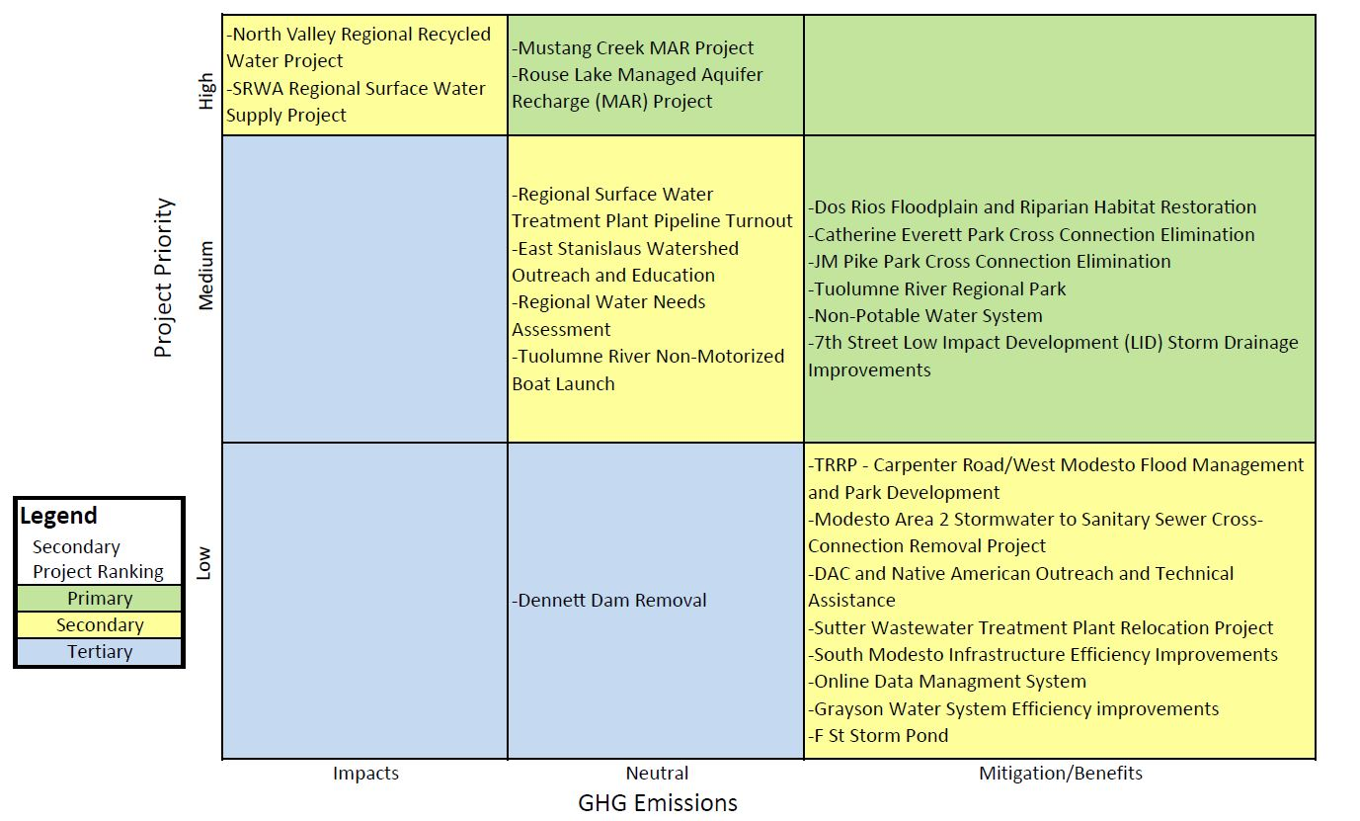
Secondary Project Ranking

